Slide 1

MATLAB xUnit Test Framework
INPE CAP 385 Desenvolvimento de Frameworks
2º Período / 2016
Luiz Wagner Tavares Nascimento

Slide 2
MATLAB xUnit Test Framework
Introdução
Apresentação do Framework
Exemplo
Considerações

Slide 3

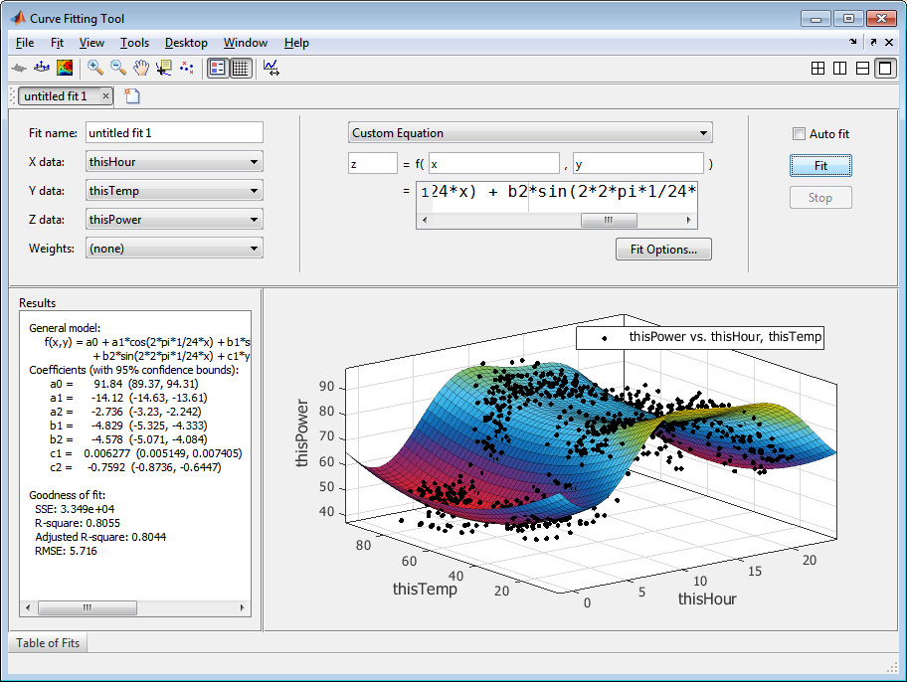
Introdução
MATLAB (MATrix LABoratory)
Linguagem de programação computacional, usando como base o cálculo de matrizes e suas aplicações

Slide 4
Framework para Teste Unitário
MATLAB xUnit Test Framework
Test the functionality and performance of your MATLAB® code
Testing your code is an integral part of developing quality software. To guide software development and monitor for regressions in code functionality, you can write unit tests for your programs. To measure the time it takes for your code (or your tests) to run, you can write performance tests.
Function-Based Unit Tests
Write tests using qualifications; customize test runner; select and run tests
Class-Based Unit Tests
Write class-based tests; parameterize tests; apply fixtures; select and run tests
Extend Unit Testing Framework
Customize testing environment; author constraints, fixtures, diagnostics, and plugins

Slide 5
Content-Based – Solution / Withdraws
Several models to find item metadata similarity
Vector Space Model, Term Frequency Inverse Document Frequency (TF/IDF)
Probabilistic models (Naïve Bayes Classifier, Decision Trees or Neural Networks)
Strategy depends on items' metadata and how much their characteristics are refined (or hard to extract content)
Algorithm can become over specialized
Difficult to exploit quality judgment from users

Slide 6
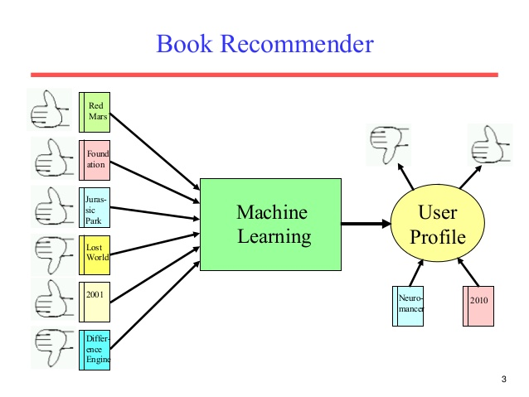







Content-Based – Examples
Citeseer, LIBRA (Learning Intelligent Book Recommending Agent)
RottenTomatoes, See this Next, Jinni
Steam, boardgamesfor.me

